Slide 1
Application Development using Node JS
Module 7 Node JS
The content is prepared from TextBook: Brad Dayley, Brendan Dayley, and Caleb Dayley , Node.js, MongoDB and Angular Web Development: The definitive guide to using the MEAN stack to build web applications, 2 nd Edition, Pearson Education, 2018

Slide 2
Introduction to Node JS
Topics to be covered
Introduction to Node.js
Who uses Node.js?
What is Node.js used for?
What does Node.js come with?
Download Node.js
Installing Node.js
Selecting a Node.js IDE

Slide 3
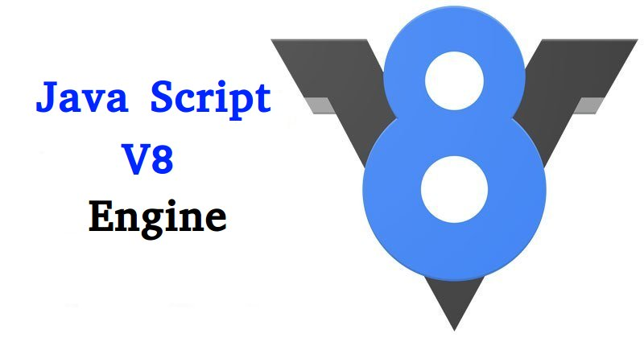
Introduction to Node JS
Node.js is a development framework based on Google’s V8 Java Script Engine for chrome web browser Topics to be covered

Slide 4
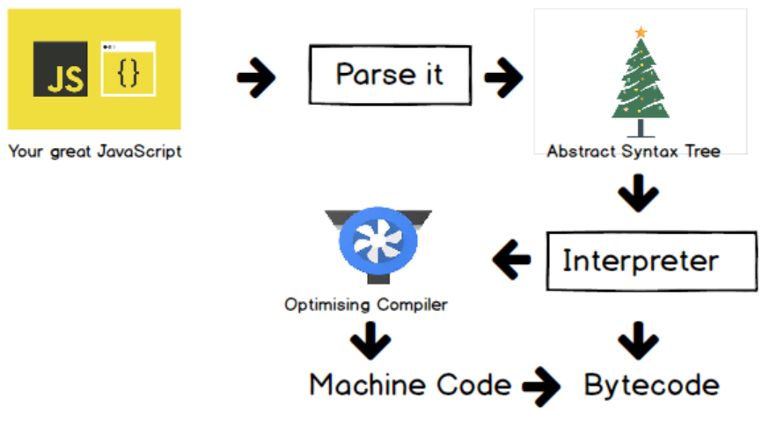
Introduction to Node JS
Code is written in Java Script
V8 compiles the code into machine code to be executed

Slide 5
Introduction to Node JS
Node.js
Server side environment
Run java script on server side
Node.js is a great framework
JavaScript end to end
Both server side and client side scripts
Event driven scalability
Single Threaded and High scalable

Slide 6
Introduction to Node JS
Extensibility
Simple to install
New modules to extend
Fast Implementation
Easy to setup Node JS and develop in it

Slide 7
Introduction to Node JS
Node.js was developed in 2009 by Ryan Dahl
Node.js is environment
Clean
Easy to install,
configure and
Deploy

Slide 8
Introduction to Node JS
Who uses Node.js?
Yahoo
LinkedIn
eBay
New York Times
Dow Jones
Microsoft

Slide 9
Introduction to Node JS
Who uses Node.js?
Yahoo
LinkedIn
eBay
New York Times
Dow Jones
Microsoft

Slide 10
Introduction to Node JS
What is Node.js used for?
Web services APIs such as REST
Real-time multiplayer games
Backend web services such as cross-domain, server-side requests
Web-based applications
Multi client communication such as IM

Slide 11
Introduction to Node JS
What does Node.js come with?
Many built in modules
Assertion Testing
Test functional
Buffer
Enables Interactions with OS and other processes
TCP Streams
File system operations
C/C++ add-ons
Allows to use c/c++ modules in Node.js

Slide 12
Introduction to Node JS
DNS
Connections to DNS Server
dns module enables name resolution
Example : use it to look up IP addresses of host names.
Errors
Error Handling
Standard JavaScript errors
System errors triggered by OS
User-specified errors triggered by application code
Assertion Errors
Events
Handling of asynchronous errors
Using Events and Listeners

Slide 13
Introduction to Node JS
File System
File I/O with both synchronous and asynchronous methods
Globals
Makes frequently used modules available without having to include them first
HTTP
Support many HTTP features
HTTPS
Enables HTTP over the TLS/SSL
Modules
Provides the module loading system for Node.js

Slide 14
Introduction to Node JS
Net
Allows the creation of servers and clients
OS
Allows access to the operating system that Node.js is running on
Path
Enables access to file and directory paths
Process
Provides information and allows control over the current Node.js process
Query String
Allows for parsing and formatting URL queries

Slide 15
Introduction to Node JS
ReadLine
Enables an interface to read from a data stream
REPL
Allows developers to create a command shell
Stream
Provides an API to build objects with the stream interface
String decoder
Provides an API to decode buffer objects into strings
Timers
Allows for scheduling functions to be called in the future

Slide 16
Introduction to Node JS
TLS/SSL
Implements TLS and SSL protocols
URL
Enables URL resolution and parsing
Utilities
Provides support for various apps and modules
V8
Exposes APIs for the Node.js version of V8
VM
Allows for a V8 virtual machine to run and compile code
ZLIB
Enables compression using Gzip and Deflate/Inflate

Slide 17
Installing Node.js
Download Node.js installer from http://nodejs.org
Node.js installer installs the necessary files on your PC to get Node.js up and running
Node.js installation location

Slide 18
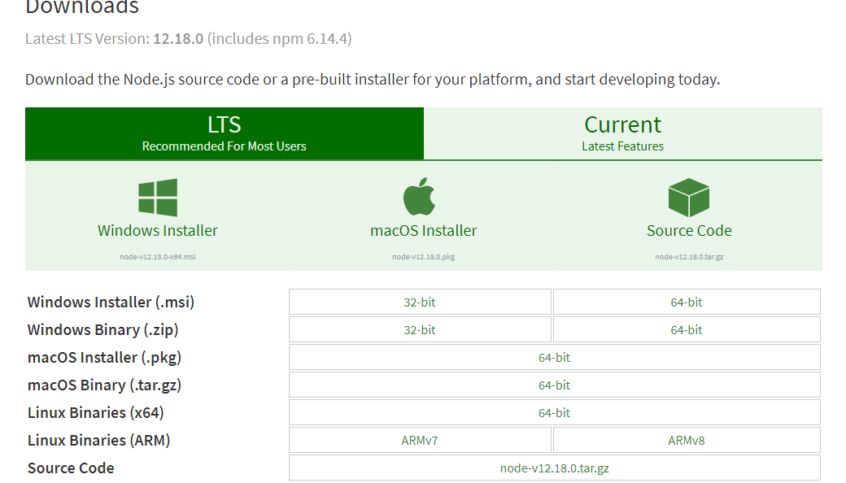

Installing Node.js

Slide 19
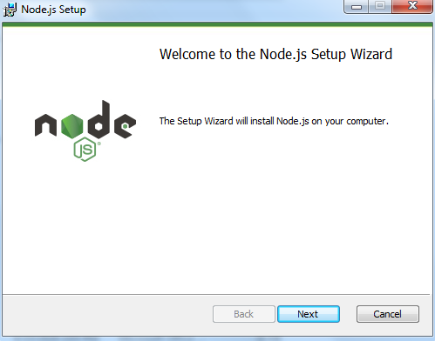
Installing Node.js

Slide 20
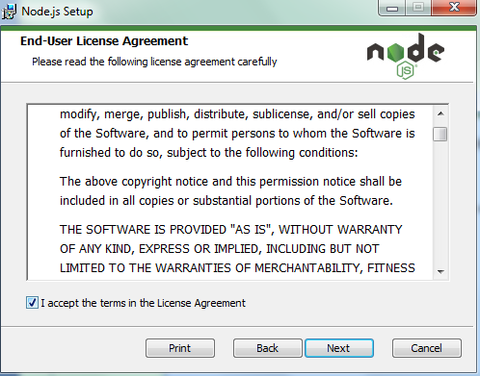
Installing Node.js

Slide 21
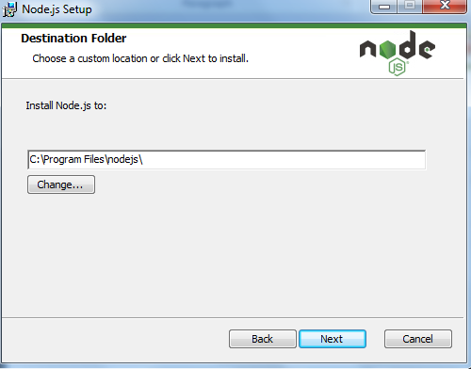
Installing Node.js

Slide 22
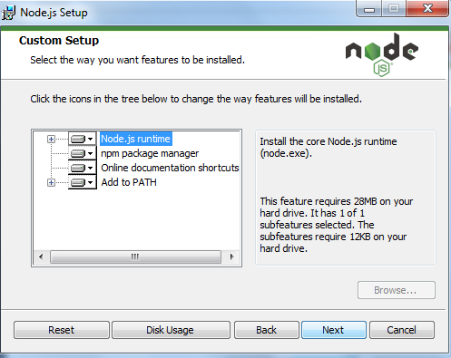
Installing Node.js

Slide 23
Installing Node.js

Slide 24
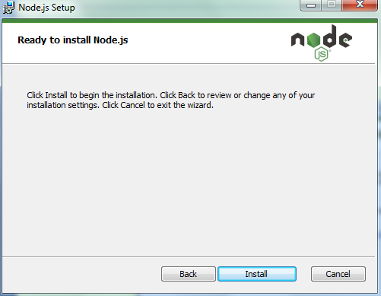
Installing Node.js

Slide 25
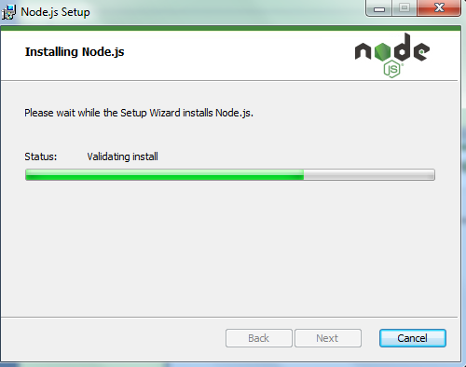
Installing Node.js

Slide 26
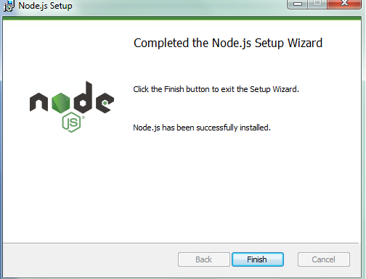
Installing Node.js

Slide 27
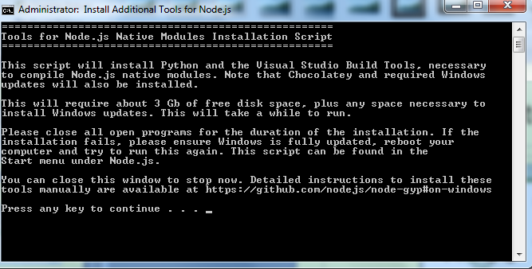
Installing Node.js

Slide 28
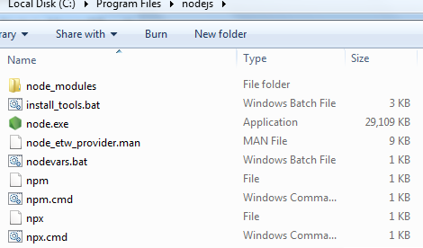
Installing Node.js
Node – starts Node.js Java Script VM
Npm – manages the Node.js packages
Node_modules – consist of Node.js packages

Slide 29
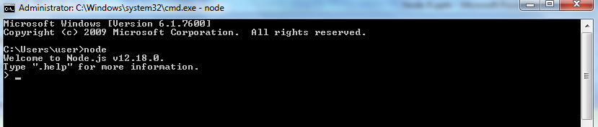
Installing Node.js
Verify Node.js Executables
To verify whether Node.js is installed and working
Execute the command “node” in command prompt

Slide 30
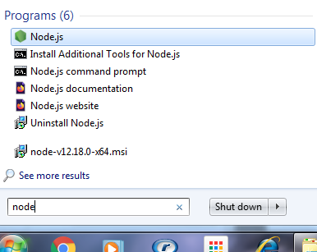
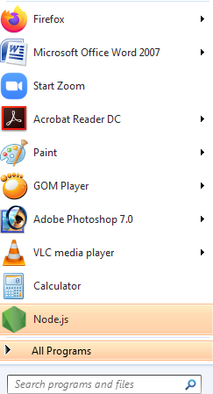
Installing Node.js
Verify Node.js Executables
To verify whether Node.js is installed and working

Slide 31
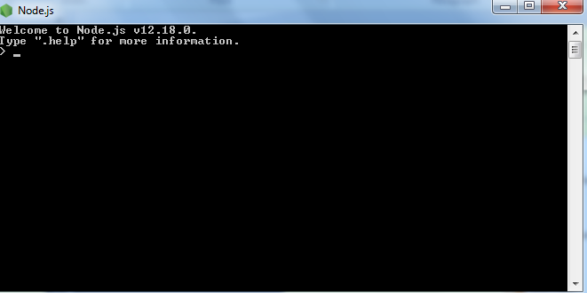
Installing Node.js
Node.js VM

Slide 32
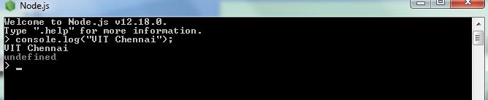
Installing Node.js
Console.log(“VIT Chennai”);
To exit from console window
Ctrl + C or Ctrl + d - Windows
Cmd+C - Mac

Slide 33
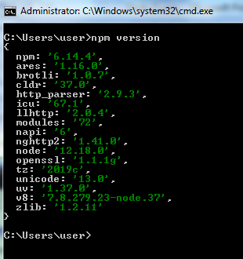
Installing Node.js
Verify npm command is working
npm version

Slide 34
Installing Node.js
Selecting a Node.js IDE
Eclipse
WebStrom
Text Editor
Code will be in
.js
.json
.html
.css

